Slide 1

Renting Cars Capstone 3

Slide 2
Introduction
A car rental System simplifies renting a car, enabling users to search for available vehicles, choose a car type, and manage their booking.
In our system, everyone can be a car supplier, Each everyone is capable of being our employee according to certain qualifications

Slide 3



Advantage of car rental
Quick Booking
Increase suppliers income
Business can be run 24/7
Online reservations

Slide 4
Class diagram

Slide 5
Endpoint (Admin)

Slide 6
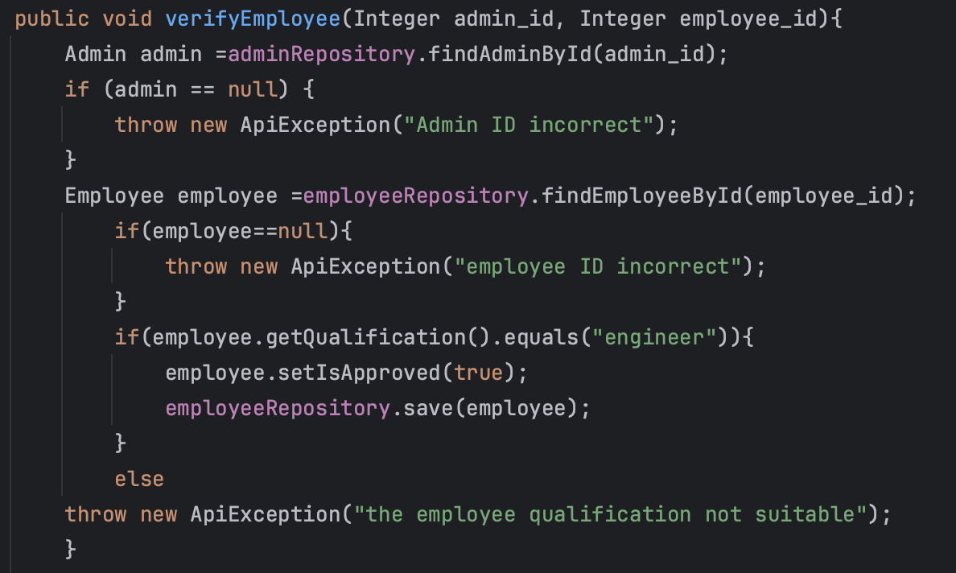
Verify employee qualification
1

Slide 7
Endpoints employee

Slide 8
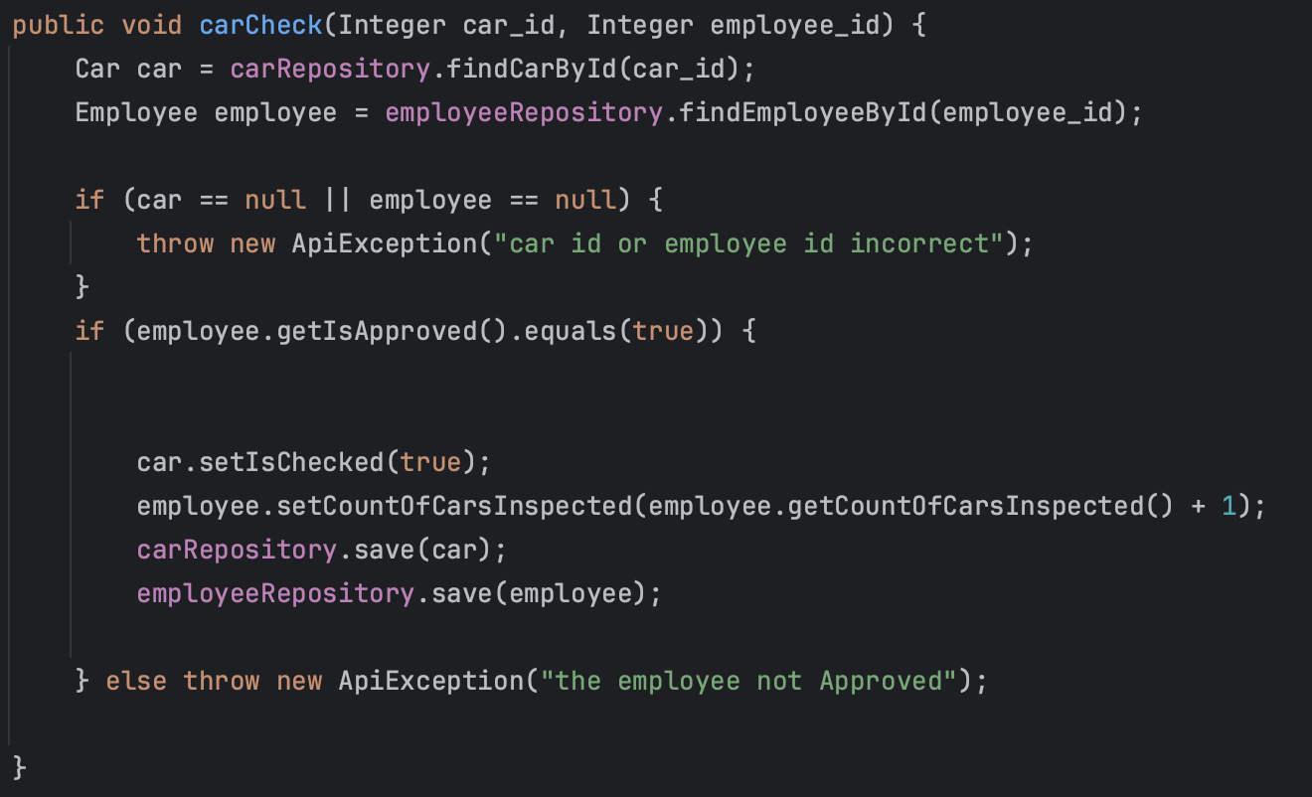
Check car by the employee
2

Slide 9
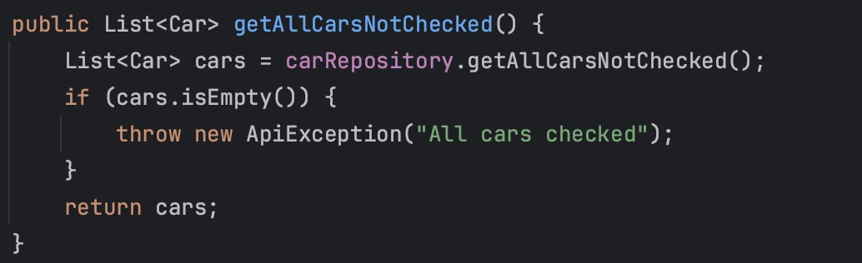
Retrieve All Cars Not Checked
3

Slide 10
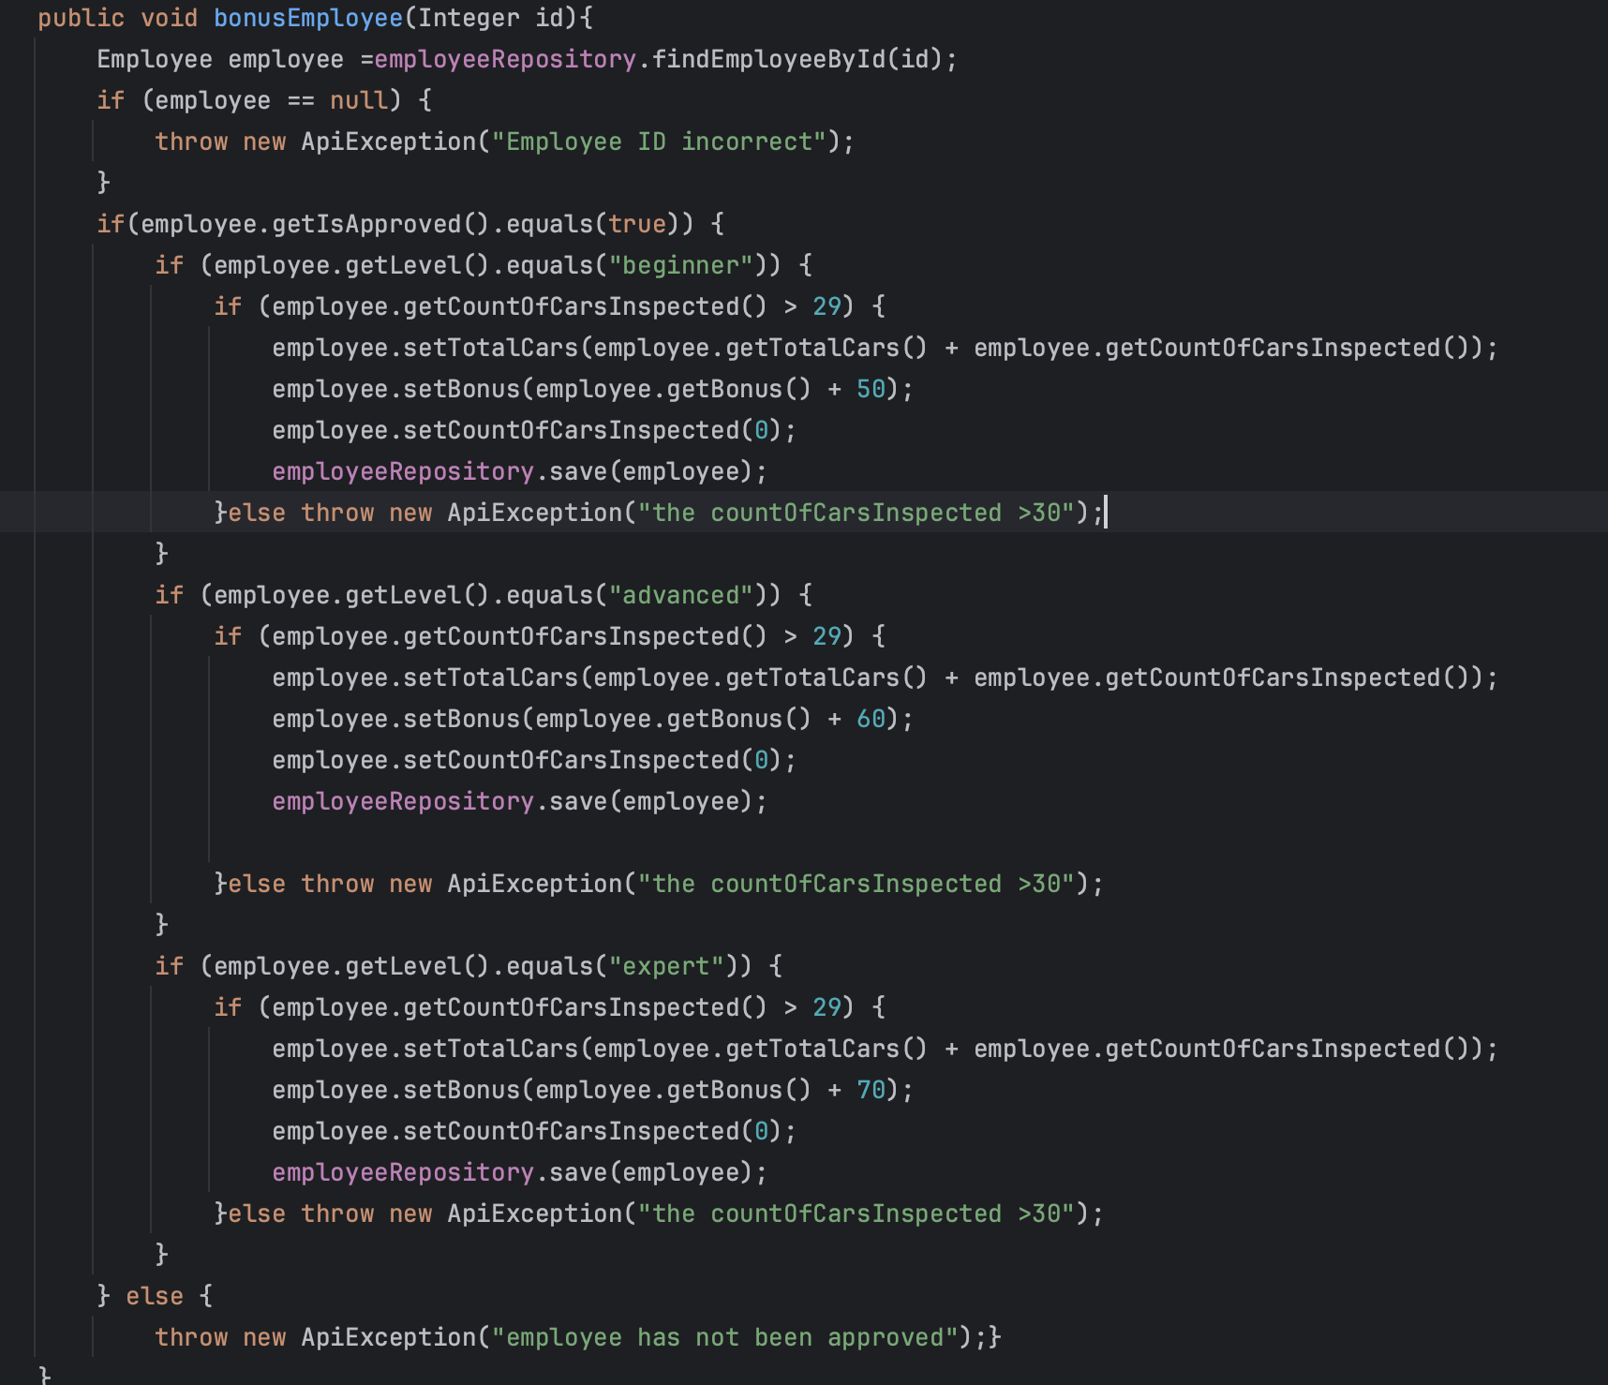
Add bonus to the employee
4

Slide 11
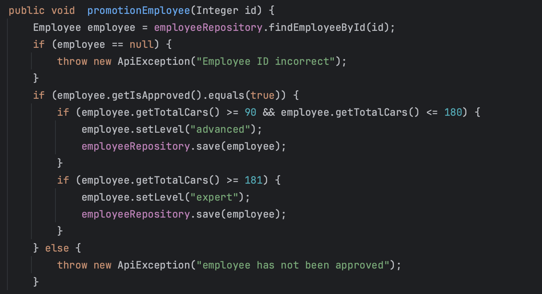
Promote employees
5

Slide 12
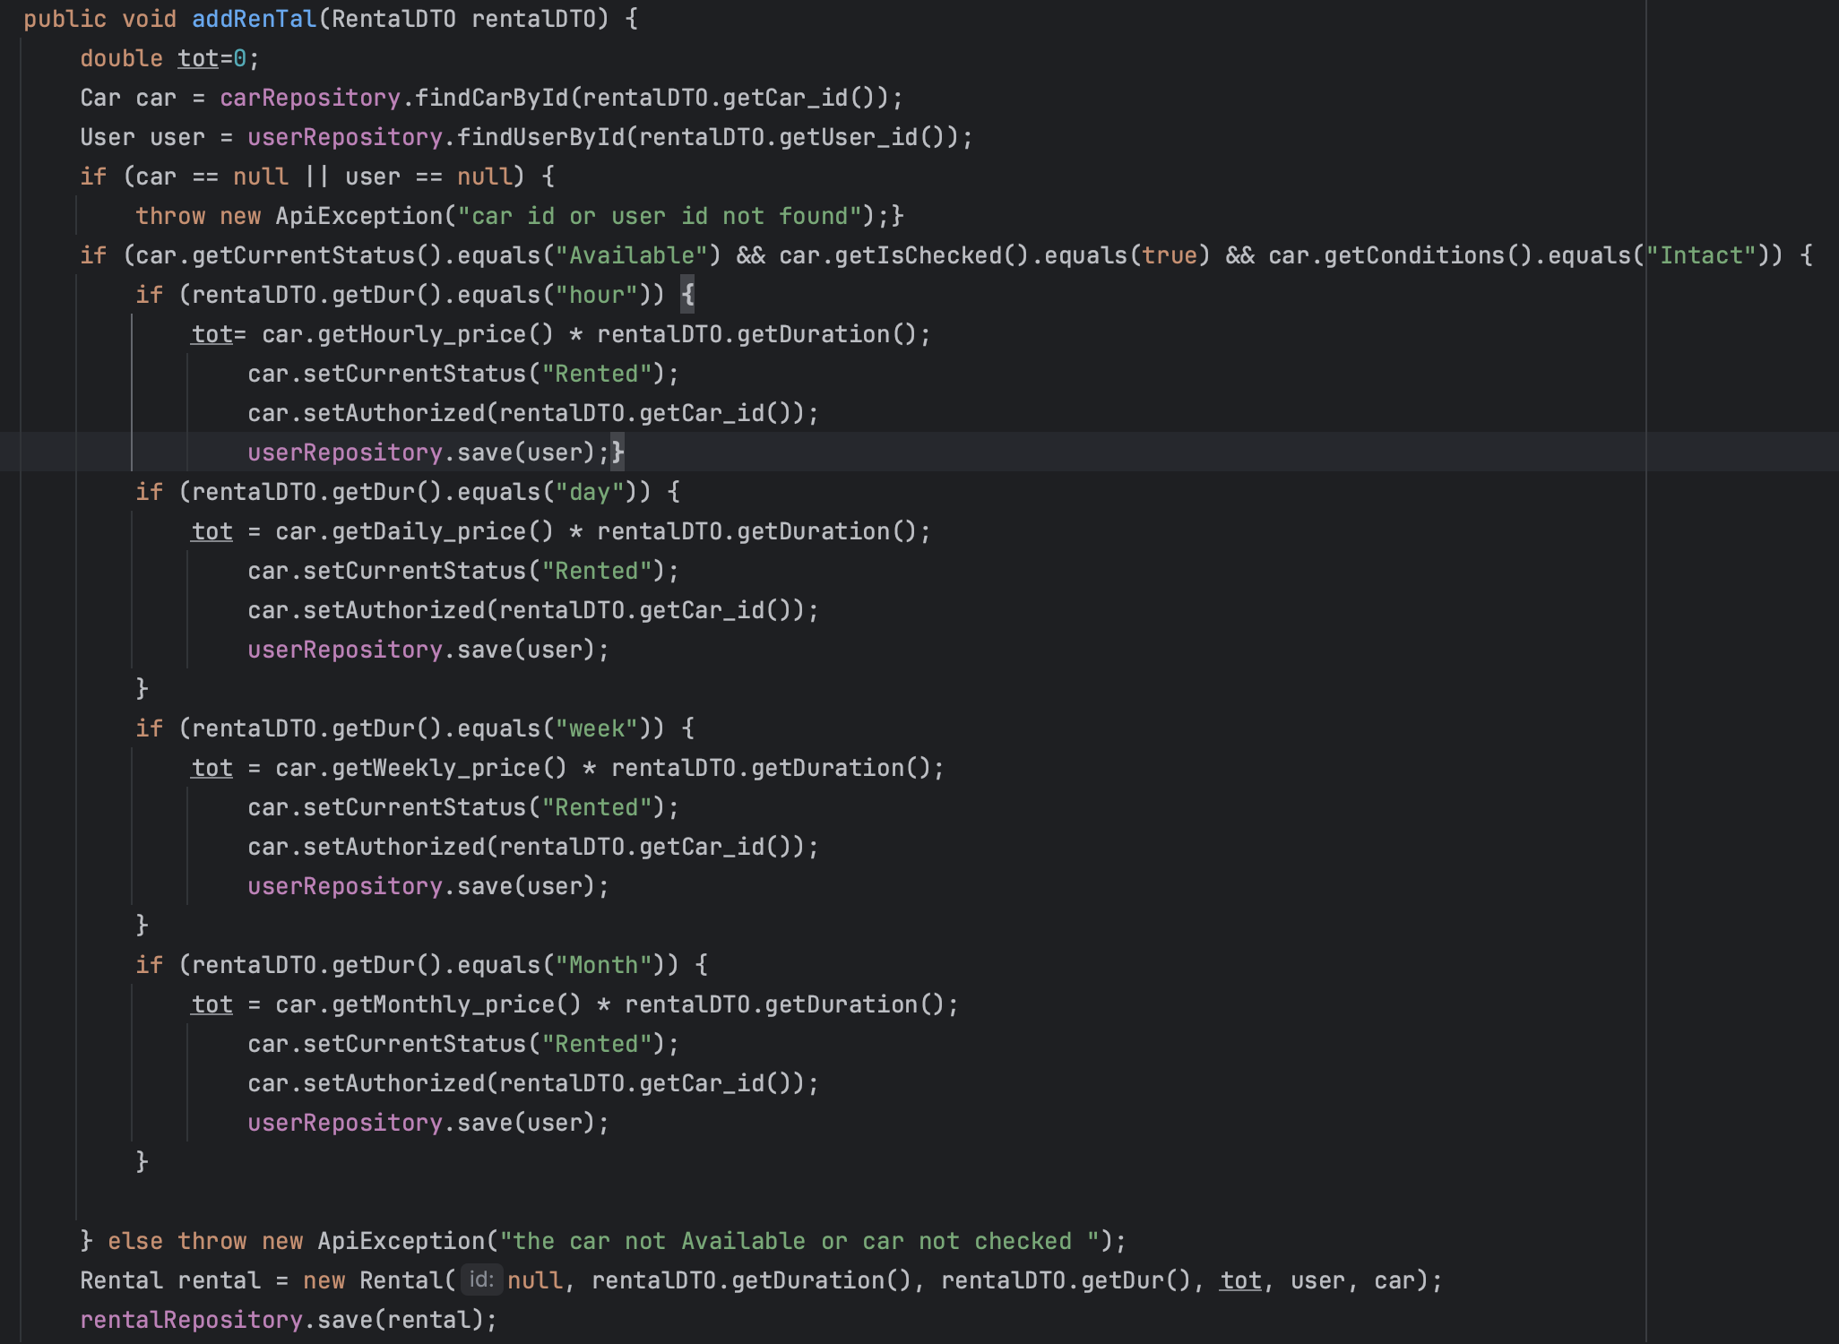
Create a new rental for renting a car
6

Slide 13
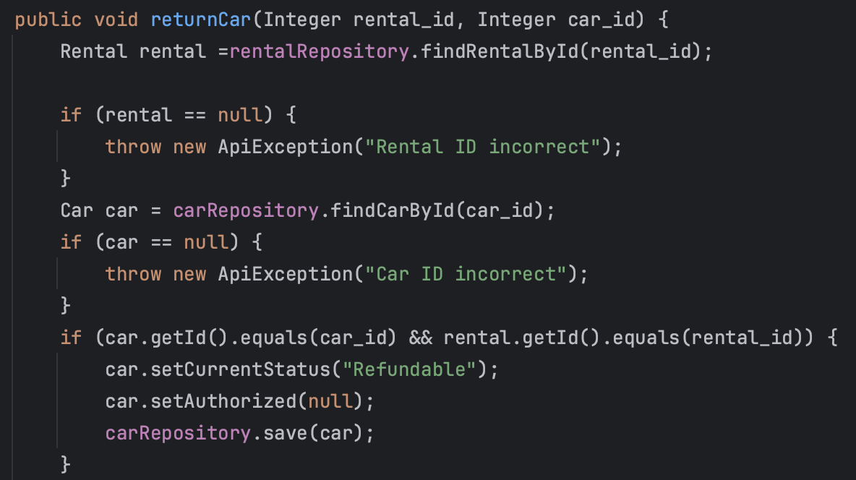
Return Car
7

Slide 14
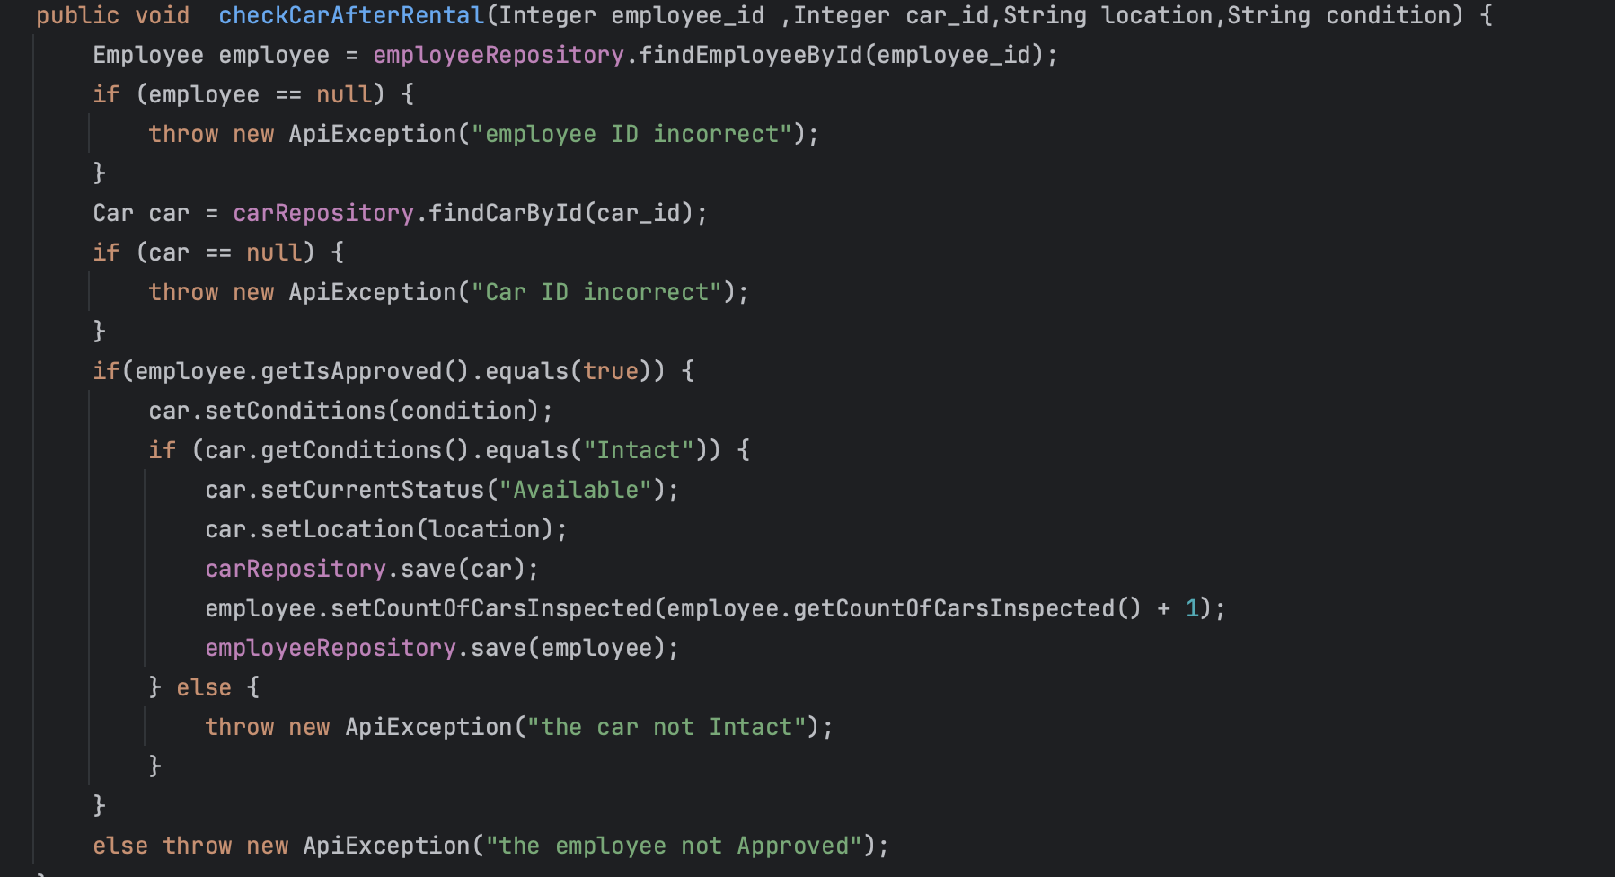
check car after the rental
8

Slide 15
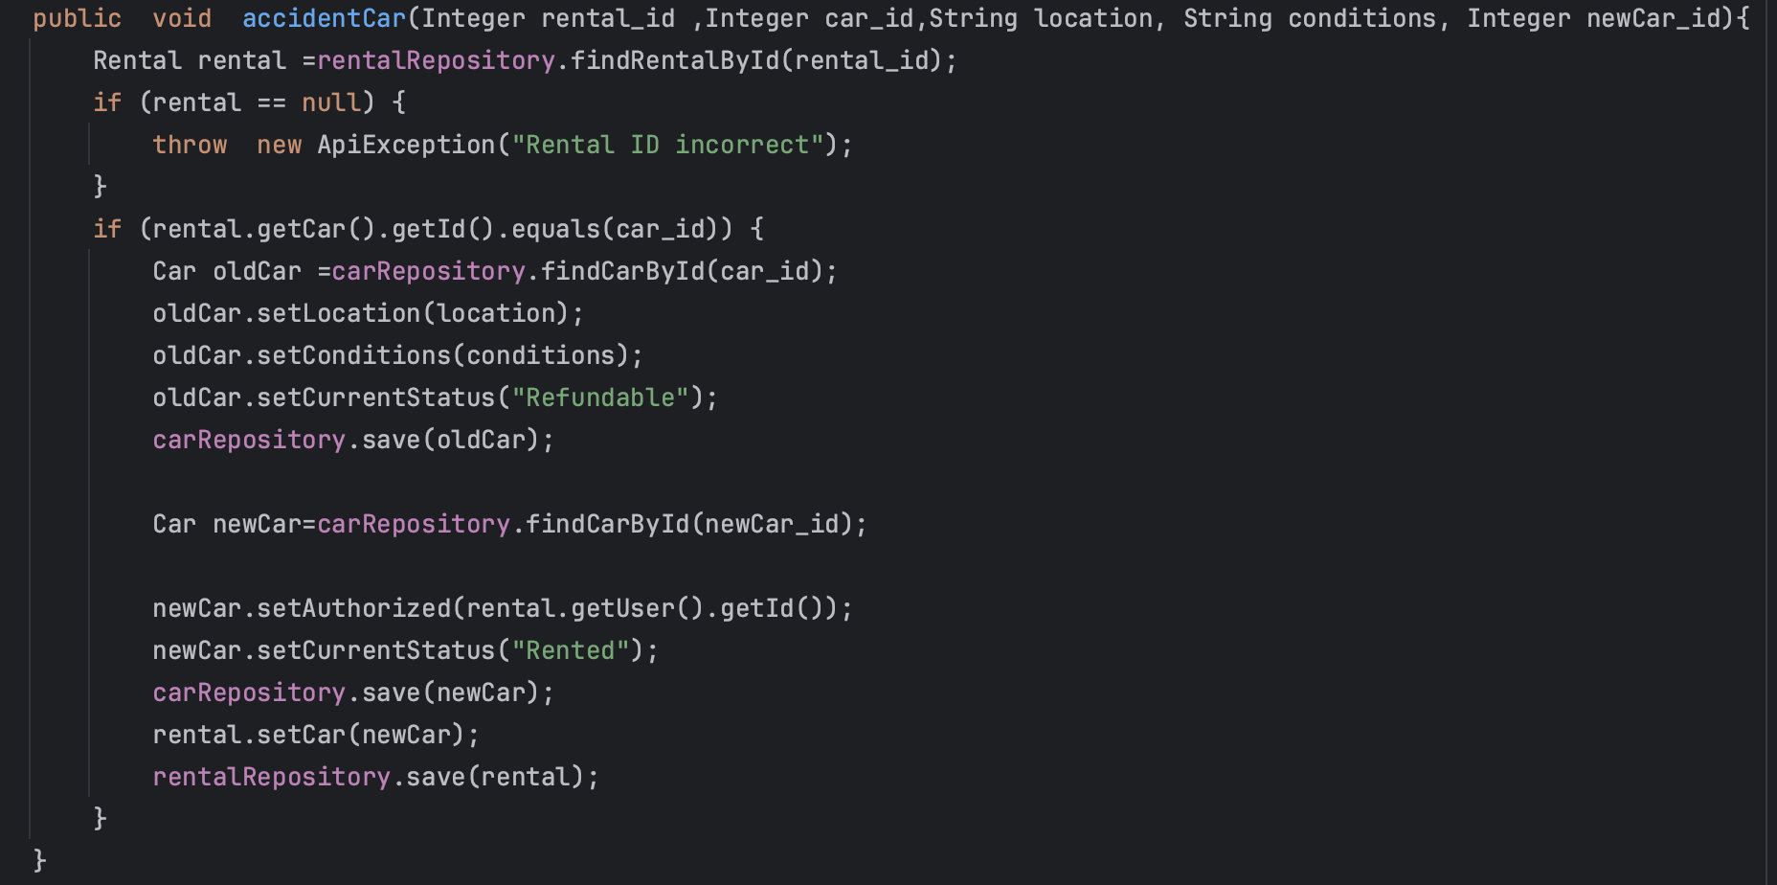
car accident
9

Slide 16
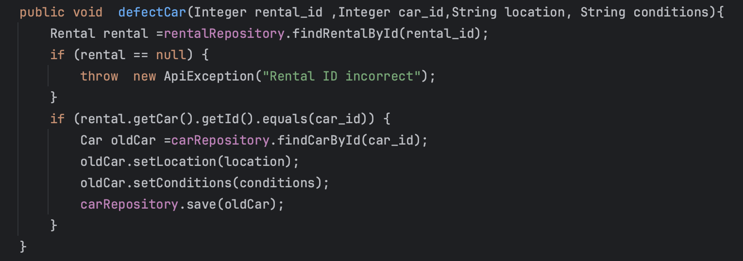
Defect Car
10

Slide 17
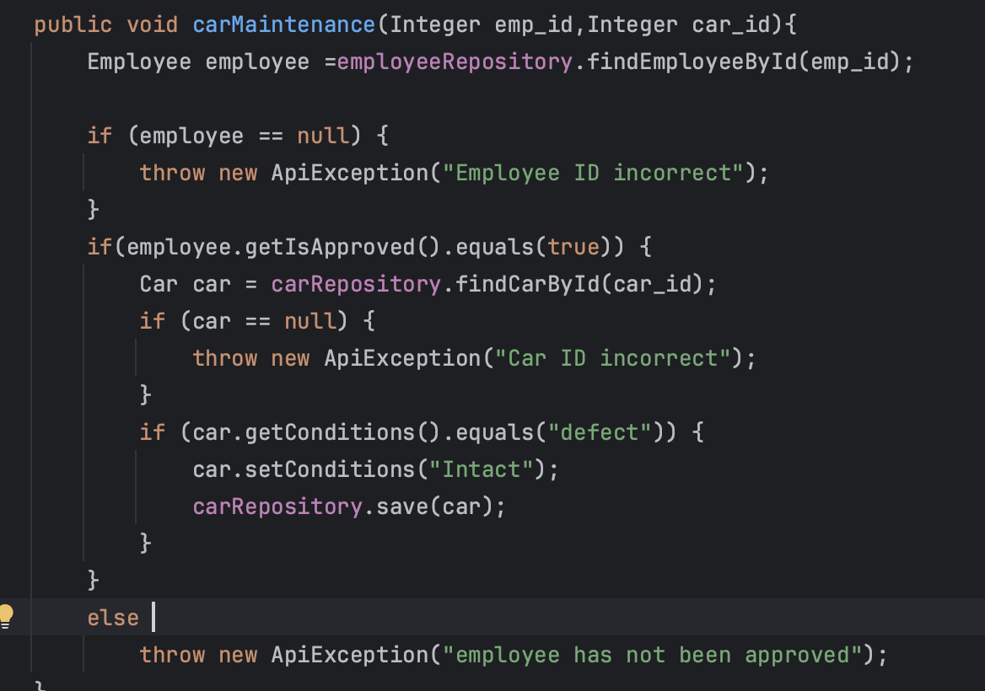
Car Maintenance
11

Slide 18
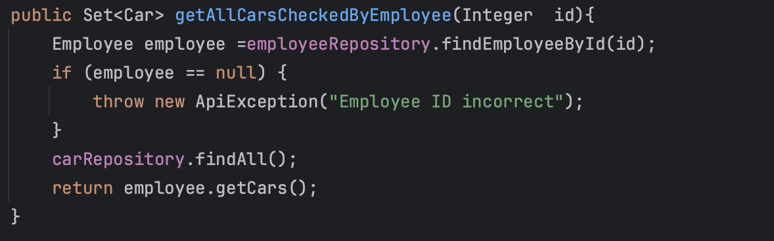
Retrieve All Cars Checked By Employee
12

Slide 19
Car endpoints

Slide 20
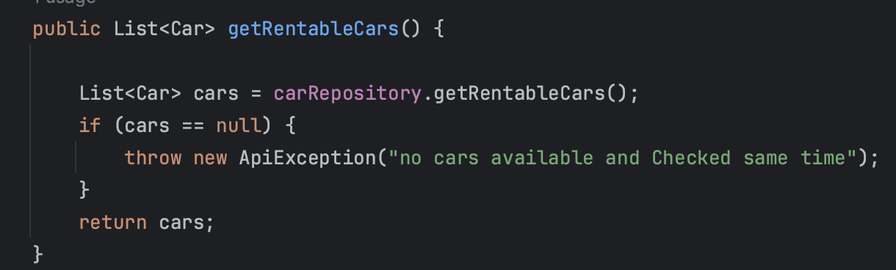
13
Retrieve a list of available cars for rent

Slide 21
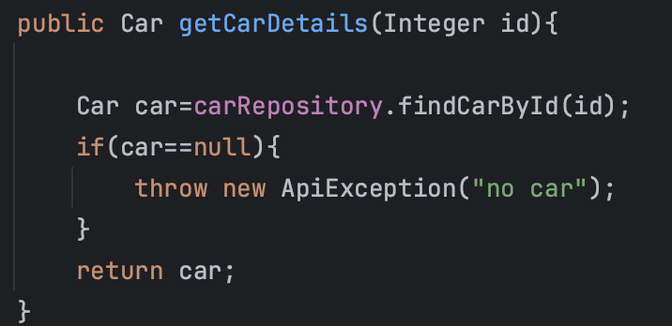
Retrieve Car Details
14

Slide 22
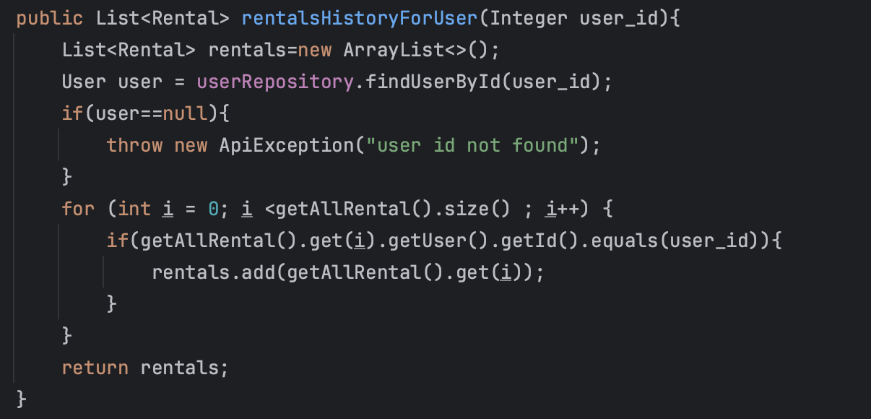
Retrieve rentals History For User
15

Slide 23
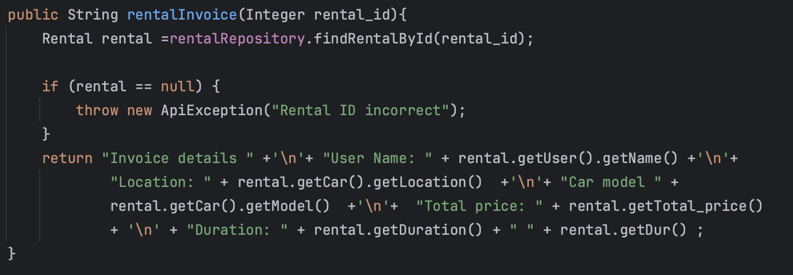
Retrieve rental invoice details
16

Slide 24
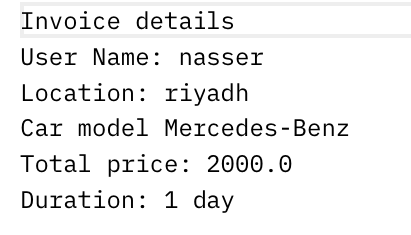
Output:

Slide 25
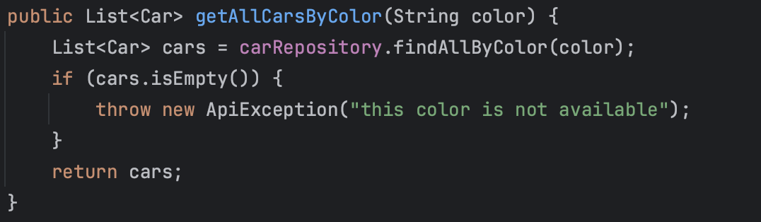
17
Retrieve all Cars by Color

Slide 26
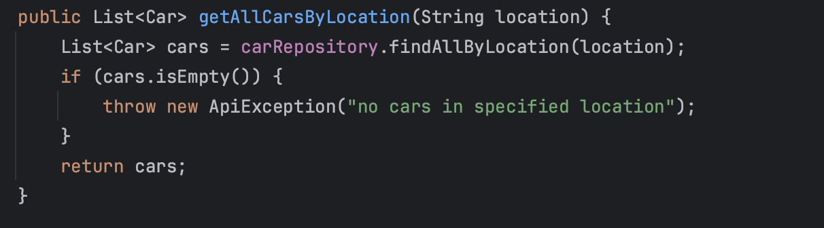
Retrieve all Cars by Location
18

Slide 27
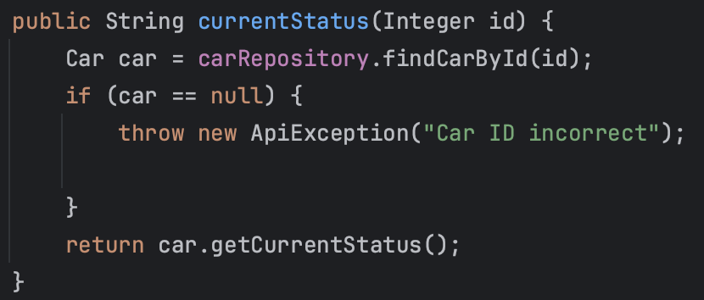
19
Retrieve Current Status

Slide 28
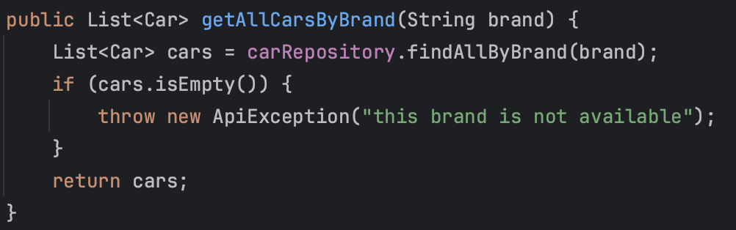
Retrieve all Car Order By Brand
20

Slide 29
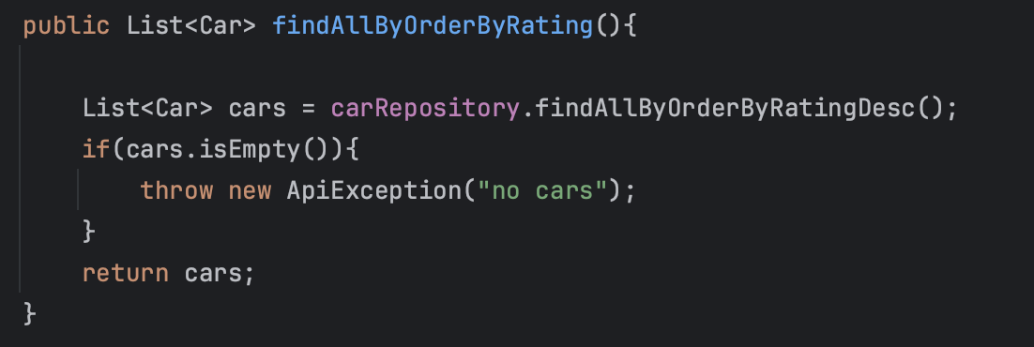
Retrieve all Car Order By Rating
21

Slide 30
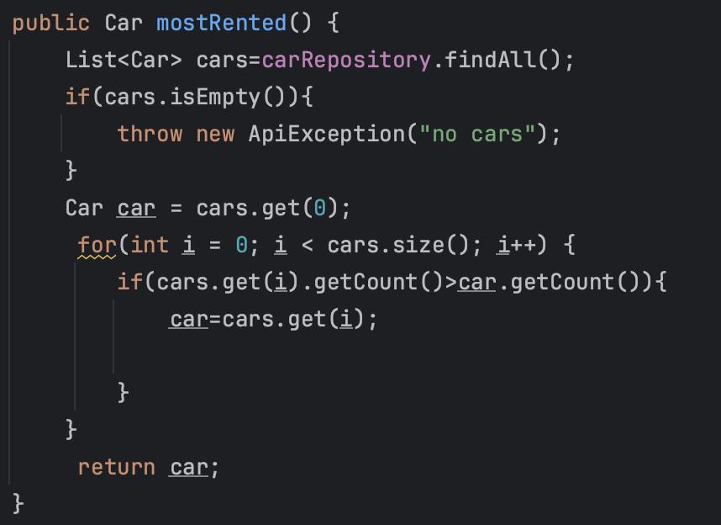
Retrieve car most rented
22

Slide 31
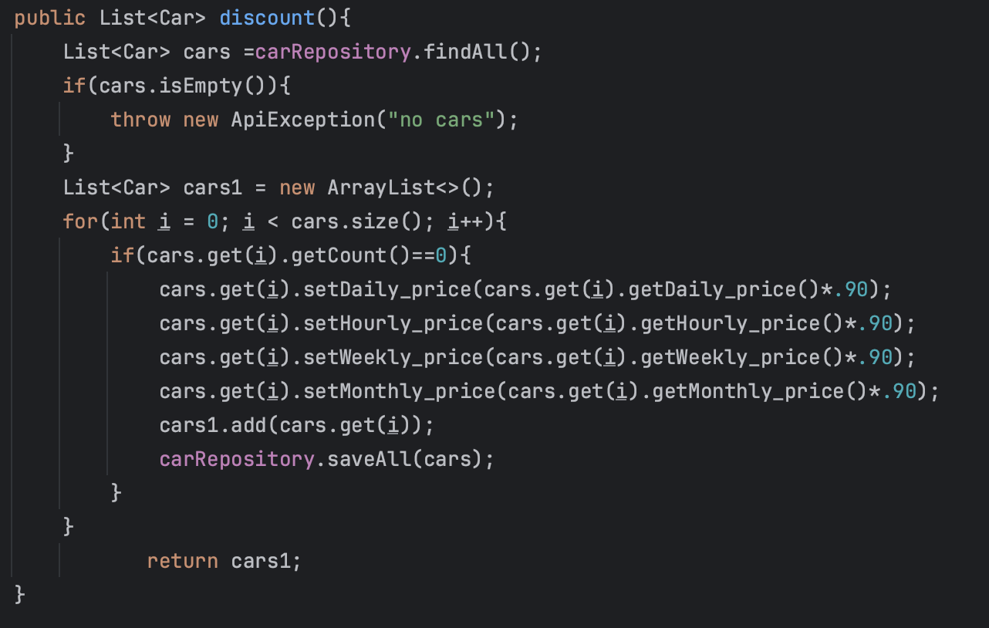
Car discounts
23

Slide 32
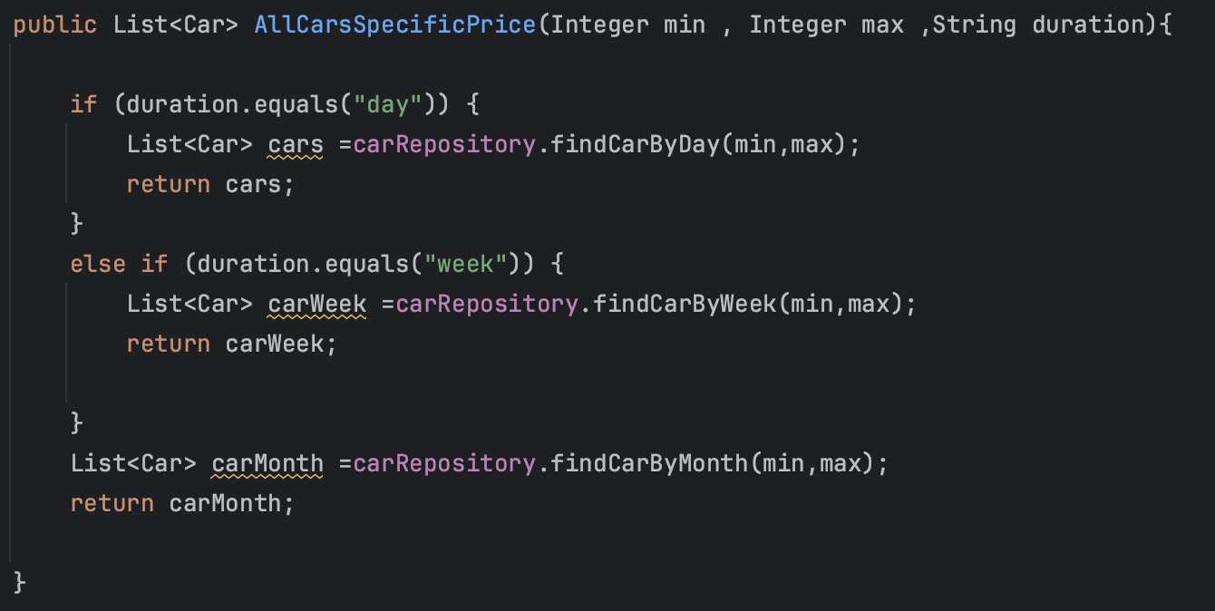
Retrieve all Cars by Specific Price
24

Slide 33
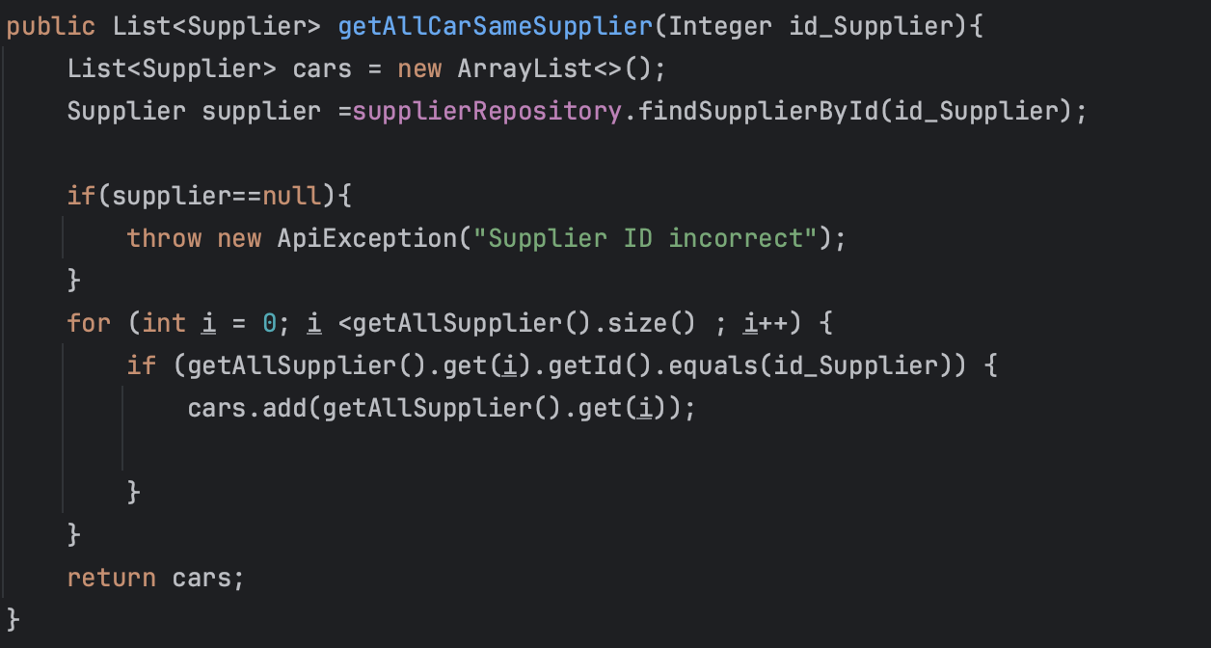
Retrieve all Cars by Supplier
25

Slide 34
Review endpoints

Slide 35
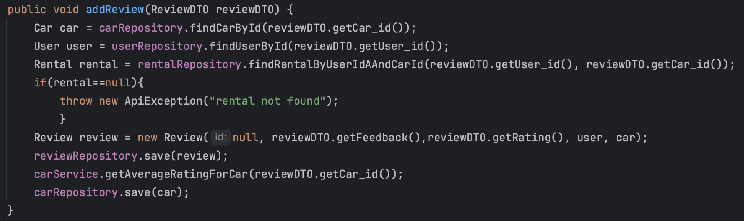
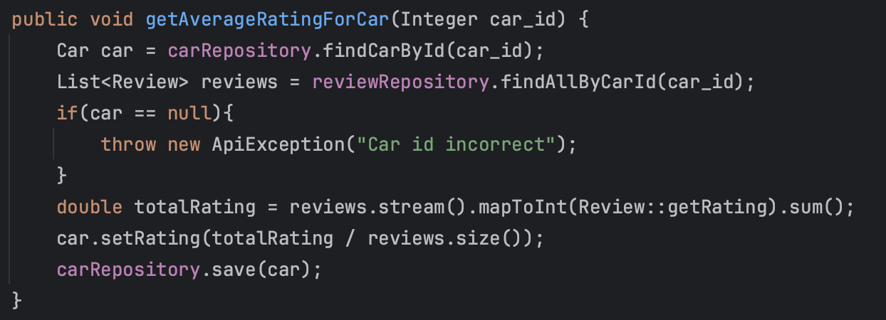
Add Review and Calculate average rating for each car
26

Slide 36
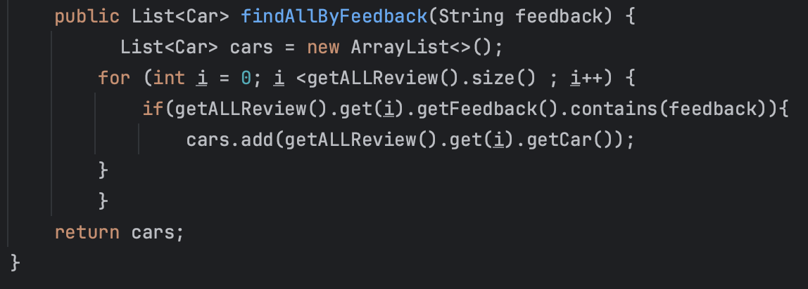
27
Retrieve all cars that contain the word in the feedback

Slide 37
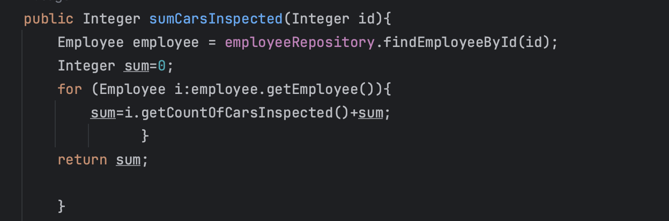
28
Sum cars of team

